Slide 1


Slide 2

Tutorial 17 Sections 009/010
TA: Greydon Gilmore
Physiology 2130
Feb 11th, 2020

Slide 3

Your TA reminding you…
3rd Peerwise assignment (1.5%)
Post 2 MC questions: due Feb 12th @ midnight
Answer 5 MC questions: due Feb 14th @ midnight
3rd Quiz (1%)
Opens: Feb 24th @ 4pm
Closes: Feb 25th @ 4pm
3rd Midterm (15%)
When: Feb 28th @ 6pm-7pm
3rd Midterm Review Session
When: Monday Feb 24th from 6pm-8pm
Where: Auditorium C, University Hospital 3rd floor

Slide 4
Today
Group work activity
Learning Catalytics Question
Respiratory Physiology

Slide 5
Answers From Last Week

Slide 6
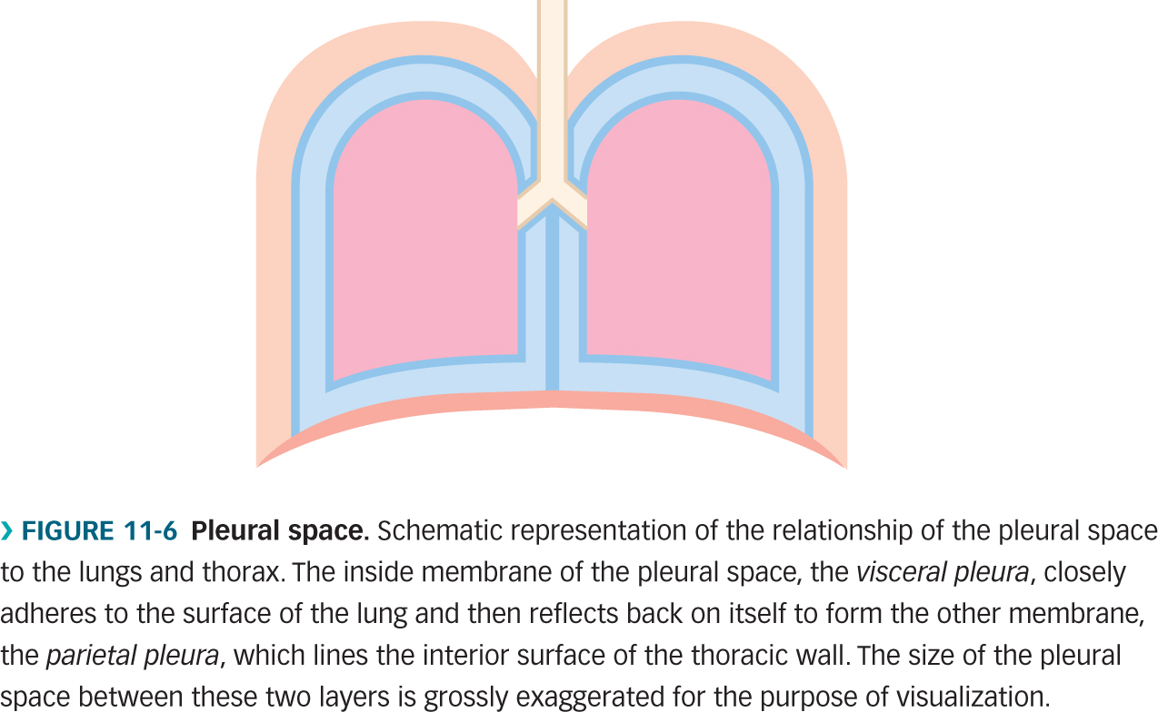
Question 1
Based on what you learned in class, what is the state of this person’s lungs in the above scenario?
This person is inhaling
This person is exhaling
This person has a pneumothorax
This person is not breathing
760 mmHg
754 mmHg
Atmospheric pressure is 760 mmHg, intrapleural pressure is 754 mmHg. At rest, the intrapleural pressure is 757 mmHg. When you breath in, the volume gets larger and the pressure gets lower (Boyle’s law). Thus, this person has to be breathing inward, since the intrapleural pressure lower than at rest.

Slide 7
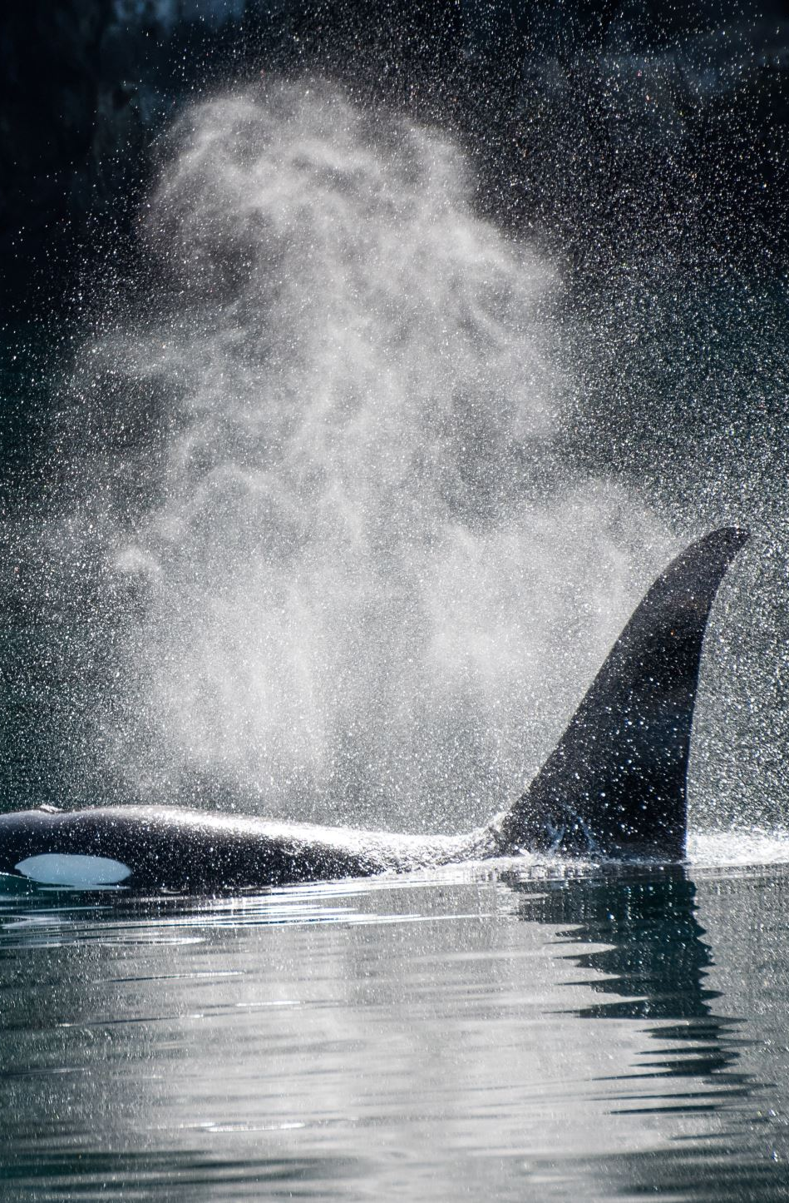
Question 2
Air is moving through your lungs but not a single muscle involved in breathing is contracting. Why?
you are inhaling at rest
you are exhaling at rest
you are inhaling while swimming hard
you are exhaling while swimming hard
When exhaling (passively) the diaphragm and external intercostal muscles relax. Swimming hard would be active breathing.

Slide 8
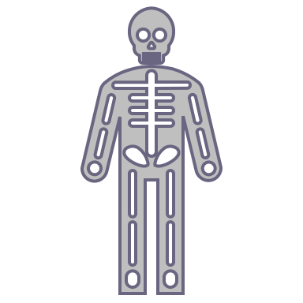
Question 3
Dorothy has a genetic condition that causes her to not produce pulmonary surfactant. What is true about Dorothy’s lungs?
Dorothy has low surface tension in her lungs
Dorothy has excellent lung compliance
Dorothy has poor gas exchange into her blood
Dorothy has too much elastin in her lungs
Pulmonary surfactant reduces surface tension, without it tension would be higher. Compliance would decrease due to the increase in surface tension. The decrease in compliance would result in poor gas exchange.

Slide 9
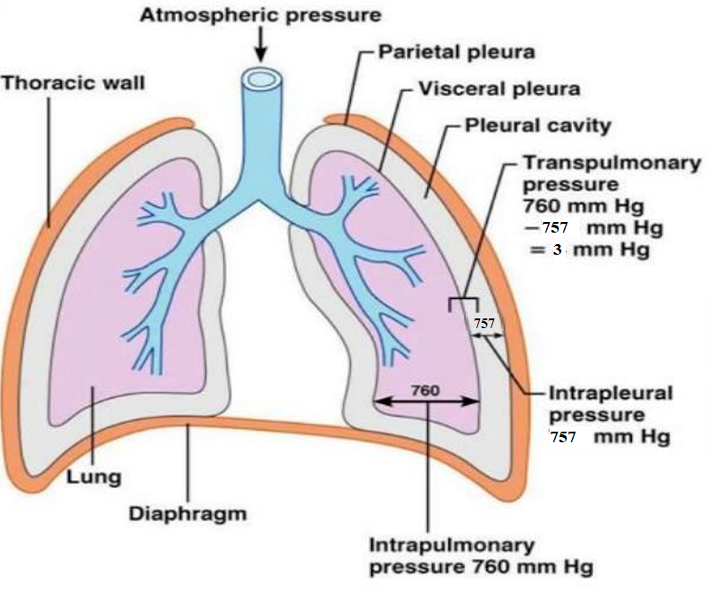
Question 4
What is true about the visceral pleura?
On one side is the lung and the other side is fluid
A hole in this membrane would cause a pneumothorax, as long as the chest wall was also punctured
This membrane directly contacts/covers the diaphragm
One membrane surrounds both lungs forming one compartment in the thoracic cavity
A hole in the visceral pleura OR parietal pleura would cause pneumothorax. Visceral pleura is next to the lung and pleural cavity.

Slide 10

Question 5
Four roommates are running. They each breathe 700 mL per breath. Based on this information alone, who likely has the best gas exchange?
They all have the same gas exchange
Matt, because he is the heaviest runner
Kate, because she breathes the slowest
Tim, because he is the lightest runner
Matt
250 lb
Kate
175 lb
Tim
160 lb
Joe
195 lb
Hint is how you calculate anatomical dead space (weight * Resp rate.). With lower resp rate the dead space would be less, meaning the alveolar ventilation would be higher! V_{A} = V_{E} - V_{D}

Slide 11
Practice Calculations
Patrick Mahomes has finished his season. In a post-game physical, his lung function test shows he has a resting tidal volume of 600 mL and breathes at 15 breaths/min. He weighs 104 kg (230 pounds).
What is his pulmonary ventilation per minute?
What is his alveolar ventilation per minute?
How much anatomical dead space does he have in his lungs?

Slide 12
Practice Calculations
Patrick Mahomes has finished his season. In a post-game physical, his lung function test shows he has a resting tidal volume of 600 mL and breathes at 15 breaths/min. He weighs 104 kg (230 pounds).
What is his pulmonary ventilation per minute?
V_{E} = V_{T} x RR = 600 mL x 15 breaths/min = 9000 mL/min or 9 L/min
What is his alveolar ventilation per minute?
V_{E} = V_{A} + V_{D}
9 L/min = ? + (230 mL * 15 breaths/min)
9 L/min = ? + (3.45 L/min)
9L/min – 3.45 L/min = V_{A}
V_{A} = 5.55 L/min
How much anatomical dead space does he have in his lungs?
Since he weighs 230 pounds, he has 230 mL of dead space in one breath.

Slide 13
Group Work

Slide 14
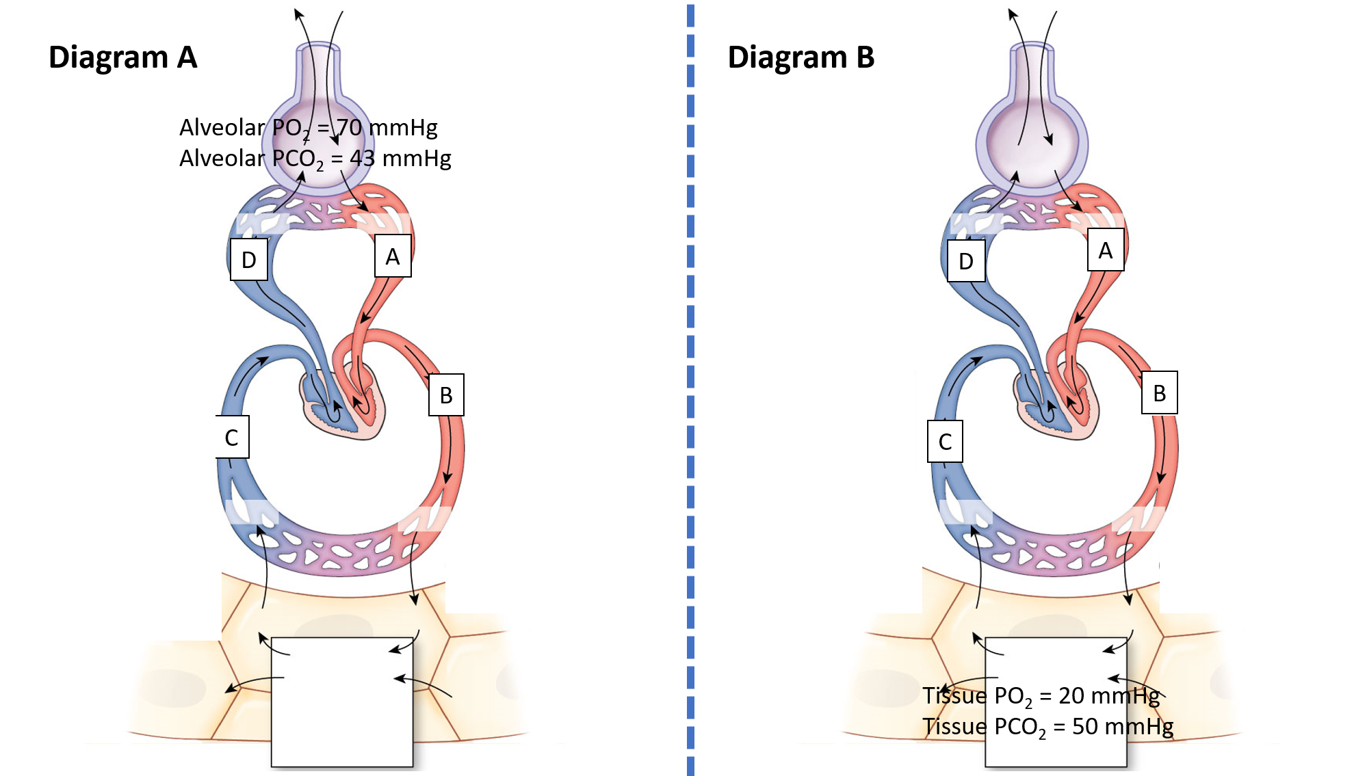
Pulmonary Diagrams
What are the blood vessels labelled A, B, C, D? Label on the figure.
Diagram A: (Assume the tissue PO₂ and PCO₂ is normal)
Fill in the PO₂ and PCO₂ for the tissues and blood vessels.
What situation might cause the partial pressures seen in the alveoli here?
What would the hemoglobin saturation be in the pulmonary vein?
(p 312-ignore any possible curve shifts to keep simple)
Diagram B: (Assume the alveolar PO₂ and PCO₂ is normal)
Fill in the PO₂ and PCO₂ for the alveoli and blood vessels.
What situation might cause the partial pressures seen in the tissue here?
What would the hemoglobin saturation be in the systemic veins?
(p 312-ignore any possible curve shifts to keep simple)

Slide 15
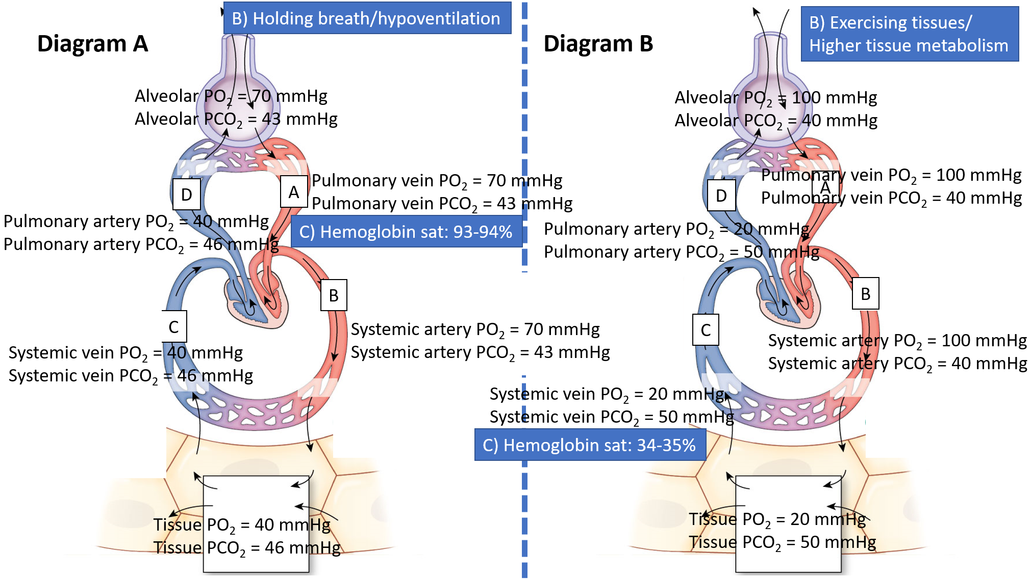
Pulmonary Diagrams Answers

Slide 16
Learning Catalytic Question

Slide 17
Respiratory System: Anatomy
Chapter 9: Dr. Beye

Slide 18
Functions of Respiratory System
Provides oxygen
Removes carbon dioxide
Regulates blood pH
Speech
Microbial defense
Chemical messenger concentrations
Traps and dissolves small blood clots

Slide 19
Lung Anatomy
Left Lung
2 Lobes
Why? The heart sits on the left side of thoracic cavity
Right Lung
3 Lobes

Slide 20
Lung Anatomy
Muscles
Intercostal muscles (between ribs)
Diaphragm (bottom)
Pleural Layers
Visceral pleura (against lungs)
Intrapleural space/cavity
Parietal pleura (against chest wall)
Visceral = Very close
Parietal = Pretty close

Slide 21
Lung Anatomy
Respiratory tract can be divided into two sections:
Conducting Zone
Respiratory Zone

Slide 22
Zones of Respiratory Tract

Slide 23
Conducting Zone
Trachea
Primary Bronchus
(Left and Right)
2⁰ Bronchi
3⁰ Bronchi
Bronchioles
Terminal Bronchioles
“Conducting zone terminates at terminal bronchioles”

Slide 24
Conducting Zone
Functions
Transport air to lungs
Filter, warm and moisten air
Microbial defense:
Bronchial epithelial cells are ciliated
Cilia sweeps mucus with trapped micro-organisms towards the trachea
Smoking reduces function of cilia

Slide 25
Respiratory Zone
Respiratory Bronchioles
Alveolar Ducts
Alveolar Sacs
Alveoli
“Respiratory zone begins at respiratory bronchioles”

Slide 26
The walls of the alveoli are composed of two types of cells, type I and II. The function of type II is to ______.
Secrete surfactant
Trap dust and other debris
Replace mucus in the alveoli
Protect the lungs from bacterial invasion

Slide 27
The walls of the alveoli are composed of two types of cells, type I and II. The function of type II is to ______.
Secrete surfactant
Trap dust and other debris
Replace mucus in the alveoli
Protect the lungs from bacterial invasion

Slide 28
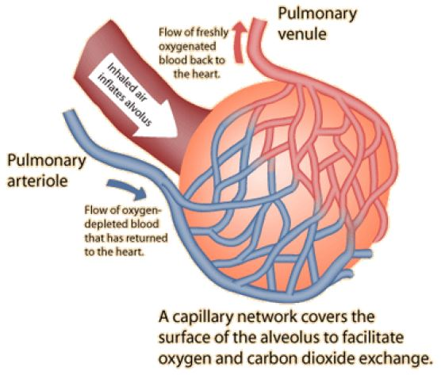
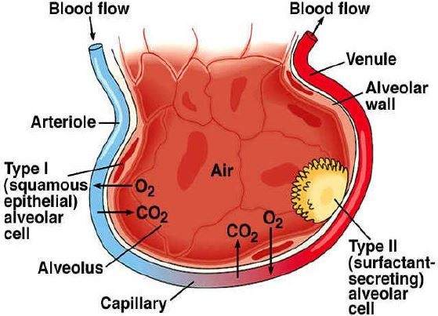
Respiratory Zone
Function
Gas exchange in the alveoli at the blood gas barrier
CO² leaves blood supply into air
O² leaves air into blood supply
Cells
Type 1 cell: flat and thin cells that form alveolar wall and allow for easy gas exchange between alveoli and capillary
Type 2 cell: secrete surfactant
Macrophages: destroy microorganisms

Slide 29
Mechanisms of Breathing
Chapter 9: Dr. Beye

Slide 30
Ventilation Calculations
Tidal Volume: Amount of air entering lungs in one breath during normal inhalation
Respiratory Rate: # of breaths per minute
Pulmonary Ventilation (V_{E}): Amount of air entering lungs (both zones) per minute
V_{E} = Tidal Volume x Respiratory Rate
Anatomical Dead Space Ventilation (V_{D}): Amount of air not involved in gas exchange (Anatomical dead space = 1 mL/pound)
V_{D} = Weight x Respiratory Rate
Alveolar Ventilation (V_{A}): Amount of air entering only the respiratory zone per minute
V_{A} = V_{E} - V_{D}

Slide 31
Ventilation Calculations
Example: For a 150 lb individual with respiratory rate of 30 breaths/min and tidal volume of 200 mL/breath
V_{E} = Tidal Volume x Respiratory Rate
= 200 x 30
= 6000 mL/min
V_{D} = Weight x Respiratory Rate
= 150 x 30
= 4500 mL/min
V_{A} = V_{E} – V_{D}
= 6000 – 4500
= 1500 mL/min
By changing your pattern of breathing, you can alter how much air is actually available for gas exchange (V_{A})

Slide 32
Complete the following statement using the choices below. Air moves out of the lungs when the pressure inside the lungs is…
Less than the pressure in the atmosphere.
Greater than the pressure in the atmosphere.
Equal to the pressure in the atmosphere.
Greater than the intra-alveolar pressure.

Slide 33
Complete the following statement using the choices below. Air moves out of the lungs when the pressure inside the lungs is…
Less than the pressure in the atmosphere.
Greater than the pressure in the atmosphere.
Equal to the pressure in the atmosphere.
Greater than the intra-alveolar pressure.

Slide 34
Pressure
Gases move down a pressure gradient
For air to move into and out of our lungs, there must be a pressure gradient
Atmospheric pressure: 760 mmHg
Intrapulmonary pressure: 760 mmHg
Since atmosphere pressure is fixed, intrapulmonary pressure must change to create a pressure gradient during respiration
Boyle’s Law:
P = 1/V (Change volume of thoracic cavity to alter pressure)

Slide 35
Inhalation
Diaphragm and external intercostal muscles contract (Diaphragm moves down and intercostals pull ribcage up and out)
Thoracic cavity expands (Increase volume)
Decrease intrapulmonary pressure by Boyle’s law (<760 mmHg)
Air moves in

Slide 36
Exhalation (Passive)
Diaphragm and external intercostal muscles relax (Diaphragm moves up and ribcage gets smaller)
Thoracic cavity decreases in volume
Increase intrapulmonary pressure by Boyle’s law (>760 mmHg)
Air moves out

Slide 37
Exhalation (Active - Exercise)
Diaphragm and external intercostal muscles relax
Internal intercostals, obliques and rectus abdominus contract
Thoracic cavity decreases in volume
Increase intrapulmonary pressure by Boyle’s law (>760 mmHg)
Air moves out

Slide 38
Intrapleural and Transpulmonary Pressure
Intrapleural Pressure: Pressure in intrapleural space; 757 mmHg
Prevents lung from collapsing at the end of expiration
Allows for easy expansion of the lung
Transpulmonary Pressure: Pressure across the lung; +3 mmHg
Intrapulmonary Pressure (760) – Intrapleural Pressure (757)

Slide 39
Pneumothorax
Spontaneous hole in visceral pleura or puncture hole in parietal pleura
Air rushes into intrapleural space
Transpulmonary pressure becomes 0 mmHg
Lung collapses in and chest wall springs out

Slide 40
During active exhalation (exercise), which of the following muscles are contracting?
1. Obliques
2. Diaphragm
3. Internal intercostals
4. External intercostals
A. 1, 2 and 3 are correct
B. 1 and 3 are correct
C. 2 and 4 are correct
D. Only 4 is correct
E. All are correct

Slide 41
During active exhalation (exercise), which of the following muscles are contracting?
1. Obliques
2. Diaphragm
3. Internal intercostals
4. External intercostals
A. 1, 2 and 3 are correct
B. 1 and 3 are correct
C. 2 and 4 are correct
D. Only 4 is correct
E. All are correct

Slide 42
The blood gas barrier is:
Formed by alveolar type I cells
Formed by alveolar type II cells
Formed by alveolar macrophages
Found in the conducting zone of the respiratory system

Slide 43
The blood gas barrier is:
Formed by alveolar type I cells
Formed by alveolar type II cells
Formed by alveolar macrophages
Found in the conducting zone of the respiratory system

Slide 44
What is true regarding a pneumothorax?
It can only occur due to damage in the visceral pleura
Transpulmonary pressure becomes 0 mmHg
Lungs balloon out and presses severely against chest cavity
Air rushes into intrapulmonary space

Slide 45
What is true regarding a pneumothorax?
It can only occur due to damage in the visceral pleura
Transpulmonary pressure becomes 0 mmHg
Lungs balloon out and presses severely against chest cavity
Air rushes into intrapulmonary space

Slide 46
Which of the following is correct regarding expiration/exhalation at rest?
Relaxation of the diaphragm increases pressure inside the lungs
External intercostal muscles contract to increase the volume of the chest cavity
Expiration at rest requires contraction of abdominal muscles
Internal intercostal muscles contract to decrease the volume of the chest cavity

Slide 47
Which of the following is correct regarding expiration/exhalation at rest?
Relaxation of the diaphragm increases pressure inside the lungs
External intercostal muscles contract to increase the volume of the chest cavity
Expiration at rest requires contraction of abdominal muscles
Internal intercostal muscles contract to decrease the volume of the chest cavity

Slide 48
Respiratory System: Measurements and Pathology
Chapter 9: Dr. Beye

Slide 49
Which of the following would increase lung compliance?
1. Increase in elastin
2. Increase in surfactant
3. Increase in surface tension
4. Decrease in collagen
A. 1, 2 and 3 are correct
B. 1 and 3 are correct
C. 2 and 4 are correct
D. Only 4 is correct
E. All are correct

Slide 50
Which of the following would increase lung compliance?
1. Increase in elastin
2. Increase in surfactant
3. Increase in surface tension
4. Decrease in collagen
A. 1, 2 and 3 are correct
B. 1 and 3 are correct
C. 2 and 4 are correct
D. Only 4 is correct
E. All are correct

Slide 51
Lung Compliance
Compliance is the “stretchability” of the lung
Compliance = Change in volume / Change in pressure
Affected by 2 factors:
Elastic tissue of lungs (33%)
Caused by presence of elastin and collagen
Surface tension in alveoli (66%)
Surfactant reduces surface tension
An increase in these 2 factors decreases compliance and increases likelihood of lung collapse

Slide 52
Pulmonary Surfactant
Released by type 2 cells
Layer is spread across air-water interface in alveoli
Surfactant = phospholipids + proteins
Phospholipids: hydrophilic head towards water; hydrophobic head towards air
Proteins: help with microbial defense
Functions:
Reduce surface tension
Improve compliance and prevent alveolar collapse
Improves microbial defense function
Proteins help identify foreign particles for macrophages
Neonatal respiratory distress syndrome (nRDS): premature infants lack mature surfactant system, which leads to poor lung function, alveolar collapse and hypoxemia (treatment = surfactant)

Slide 53
Spirometry
Spirometer is used to measure lung volumes and diagnose some respiratory diseases

Slide 54
Spirometry
IRV (3L): Max volume of air that can be inhaled after a normal inspiration
VC (4.5L): TV + IRV + ERV
ERV (1L): Max volume of air that can be exhaled after a normal inspiration
TV (0.5L): Volume of air moved into or out of lungs during normal breathing
TLC (6L):
TV + IRV + ERV + RV
RV (1.5L): Volume of air remaining in lungs after a max expiration

Slide 55
Other Lung Measurements
Forced vital capacity (FVC): how much air a person can exhale as fast as possible during a forced breath
Forced expiratory volume (FEV₁): volume of exhalation over 1 second

Slide 56
What is true of a restrictive lung disease?
Emphysema is an example of a restrictive lung disease
Lungs can become floppy due to Loss of elastin
FEV1 decreases
FVC decreases

Slide 57
What is true of a restrictive lung disease?
Emphysema is an example of a restrictive lung disease
Lungs can become floppy due to Loss of elastin
FEV1 decreases
FVC decreases

Slide 58
Normal vs. Diseases
FEV₁
FVC
FEV₁ = Volume in 1 sec
FVC = Amount air in forced breath
Normal | Obstructive | Restrictive
FEV1 | Decreases | No Change
FVC | No Change | Decreases
FEV1/FVC = 80 % | FEV1/FVC < 80% | FEV1/FVC > 80%
Examples | Asthma, chronic bronchitis, emphysema | Pulmonary fibrosis

Slide 59
Lung Diseases: Obstructive
Air flow obstruction during exhalation
Diameter of bronchioles decreases (lumen constricted)
 | Cause | Effect
Asthma | Spasms triggered by exercise, air pollution and allergies | Airway inflammation and hyper-responsiveness
Chronic Bronchitis | Smoking | Excessive mucus and inflammation
Emphysema | Smoking | Alveolar wall break down creates large air sacs ( surface area = poor gas exchange) Loss of elastin reduces elastic recoil ( compliance so lungs fill but can’t empty)
Compliance = Volume / Pressure

Slide 60
Lung Diseases: Restrictive
Air flow restriction during inhalation
 | Cause | Effect
Pulmonary Fibrosis | Chronic inhalation of asbestos, coal, dust, pollution or sometimes unknown | Fibrous scar tissue (thickened tissue) in alveoli and other lung tissue Due to thick walls, poor gas exchange (similar to emphysema but different reason) Lungs become stiff due to in collagen = compliance (opposite to emphysema)
Compliance = Volume / Pressure

Slide 61
Next Tutorial (Feb 25th)
More respiratory physiology!

Slide 62
What Questions Do You Have?
You can ask in the Owl forums as well!
Also anonymously ask questions in the online dropbox!!

